Slide 1
Machine learning based autism prediction
GUIDE DETAILS NAME:S.KISHORE
DR.P.GEETHA MCA-FINAL YEAR
ROLL NO:2019202027

Slide 2
MOTIVATION & OBJECTIVE
MOTIVATION:
The motivation is to find the child is autistic or non-autistic by using image dataset of children.
OBJECTIVE:
(i)To make the image clear, we are using preprocessing method
(ii)To calculate whether it is high clustering or low clustering, we are using GLCM algorithm.
(iii)To extract featurization by means of calculating image brightness, contrast, entropy, mean, variance.
(iv)Finally we are predicting whether the child is autistic or non-autistic by using CNN algorithm.

Slide 3
DOMAIN INTRODUCTION
MACHINE LEARNING:
(i)In the statistical context, Machine Learning is defined as an application of artificial intelligence where available information is used through algorithms to process or assist the processing of statistical data.
(ii)While Machine Learning involves concepts of automation, it requires human guidance. Machine learning is a relatively new discipline within Computer Science that provides a collection of data analysis techniques.
(iii)Some of these techniques are based on well established statistical methods (e.g. logistic regression and principal component analysis) while many others are not.
SIGNIFICANCE OF MACHINE LEARNING:
(i)Machine Learning is one of the most popular sub-fields of Artificial Intelligence. Machine learning concepts are used almost everywhere, such as Healthcare, Finance, Infrastructure, Marketing, Self-driving cars, recommendation systems, chatbots, social sites, gaming, cyber security, and many more.
(ii)Training is the most important part of Machine Learning. Choose your features and hyper parameters carefully. Machines don't take decisions, people do. Data cleaning is the most important part of Machine Learning.
IMPACT OF MACHINE LEARNING:
As ML algorithms gain experience, they keep improving in accuracy and efficiency. This lets them make better decisions. Say you need to make a weather forecast model. As the amount of data you have keeps growing, your algorithms learn to make more accurate predictions faster.

Slide 4
Literature review
S.NO | AUTHOR NAME & PAPER | CONCEPT IN THE PAPER | PAPER DETAILS
1. | Cognitive Load Measurement in a Virtual Reality-Based Driving System for Autism Intervention Lian Zhang; Joshua Wade | Algorithm used:svm,knn, Decision Tree, Discriminant analysis, ANN LIMITATIONS: we lost a relatively large quantity of data (20.56 percent of all the data). The data were lost primarily due to participants’ movements during driving, which was inevitable in the VR-based driving system aiming at training driving skills of adolescents with ASD in naturalistic conditions. FUTURE WORK: (i)The extant literature supports the usefulness of driving simulators. (ii)Evaluating the usefulness of training using our VR-based driving system for real world driving, in terms of speed-maintenance and error-reduction, will be carried out in future work. | Issue:APRIL-JUNE 2019 PUBLISH:IEEE

Slide 5
S.NO | AUTHOR NAME AND PAPER | CONCEPT IN THE PAPER | PAPER DETAILS
2. | Identification of Autism Based on SVM-RFE and Stacked Sparse Auto-Encoder Canhua Wang; Zhiyong Xiao | ALGORITHM:SVM-RFE LIMITATIONS:In this study, a deep learning method combined with SVM-RFE was proposed to improve the classification accuracy of ASD based on the whole ABIDE dataset. The proposed method used SVM-RFE to pre-eliminate some meaningless features in order to enable the SSAE to extract well the sophisticated features in the case of ‘‘high dimensions, small samples’’. FUTURE WORK: Further research is necessary to combine multiple indices of brain imaging such as grey matter volume and cortex thickness with the FC, which might lead to better results of identification. | Issue:AUGUST-SEPTEMEBER 2020 Publish:ieee

Slide 6
S.NO | AUTHOR NAME & PAPER | CONCEPT IN THE PAPER | PAPER DETAILS
3. | Computer Aided Autism Diagnosis Using Diffusion Tensor Imaging Yaser A. Elnakieb; Mohamed T. Ali | ALGORITHM USED:DTI-Based ASD Diagnosis System LIMITATIONS:In summary, the proposed diagnosis framework achieved various goals. The classifier’s performance, with a moderately large sample size of 263 subjects, is in the upper range of those DTI-based studies reported in the literature. FUTURE WORK: The feature selection approach used in our system is scalable, in that additional imaging modalities or even non-image data could be incorporated into the feature space, and their contribution to the classification could be considered separately or jointly | ISSSUE:APRIL2020 Publish:ieee
4. | Classification and Biomarker Exploration of Autism Spectrum Disorders Based on Recurrent Attention Model | ALGORITHM USED:CNN,RNN LIMITATIONS:In this article, we use the RAM and sMRI in deep learning to classify autism and visualize the classification evidence. We replace the PG algorithm with DDPG algorithm in RAM, and propose prioritized experience replay algorithm based on Gaussian sampling method. FUTURE WORK: The future research will be carried out in other visualization models to further mine the relevant information of lesions in the autistic brain. | ISSUE:NOVEMBER 2020 Publish:ieee

Slide 7
S.NO | AUTHOR NAME & PAPER | CONCEPT IN THE PAPER | PAPER DETAILS
5. | Affective computing of children with autism based on feature transfer Author name:Jing han,xue li | Algorithm used:sparse coding algorithm Limitations:The effect of emotion recognition is lower than that of algorithm in this paper it is superiority of the algorithm Future enhancements:The optimization analysis of the objective function realized by alternating iterations | ISSUE:Decemeber 2020 PUBLISH:CCIS

Slide 8
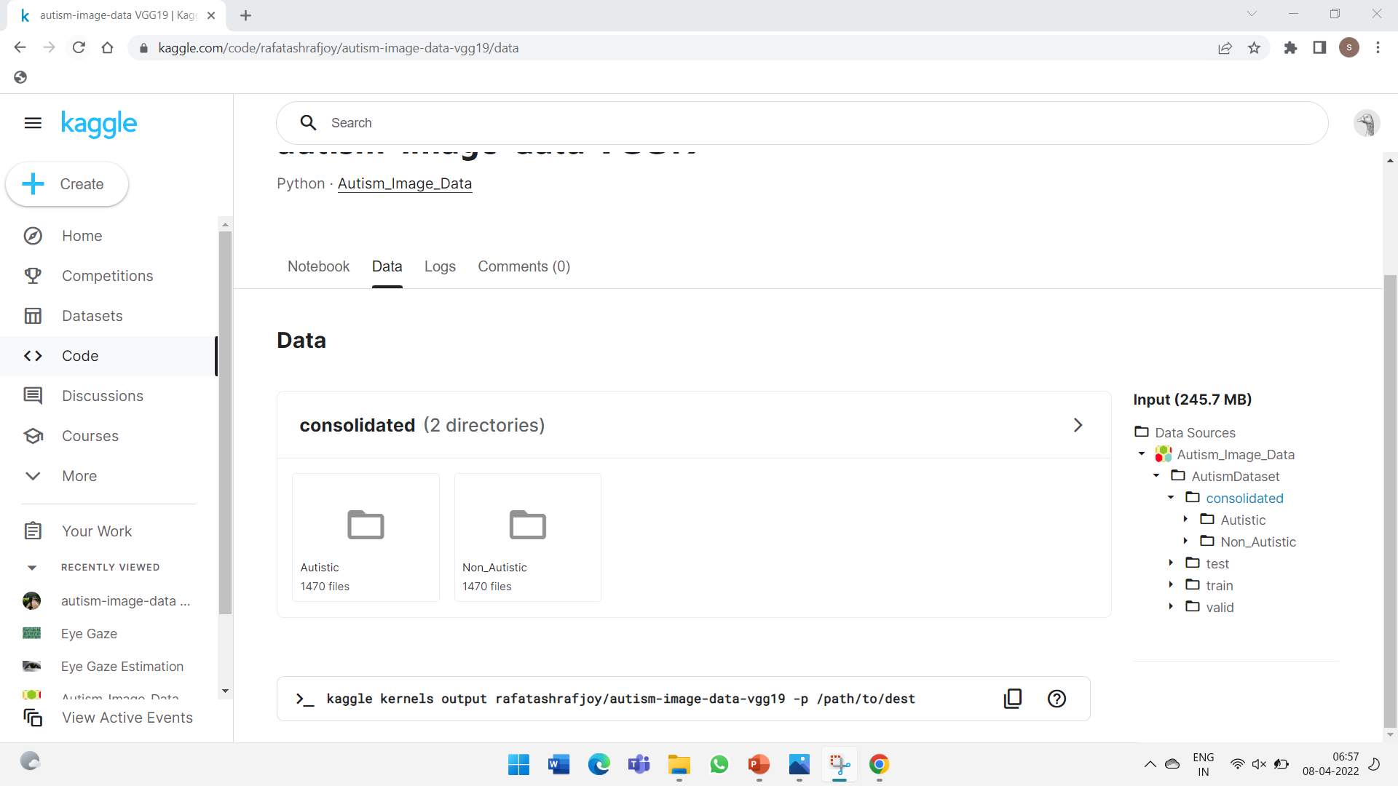
DATASET DETAILS
Children image dataset is taken from Kaggle

Slide 9
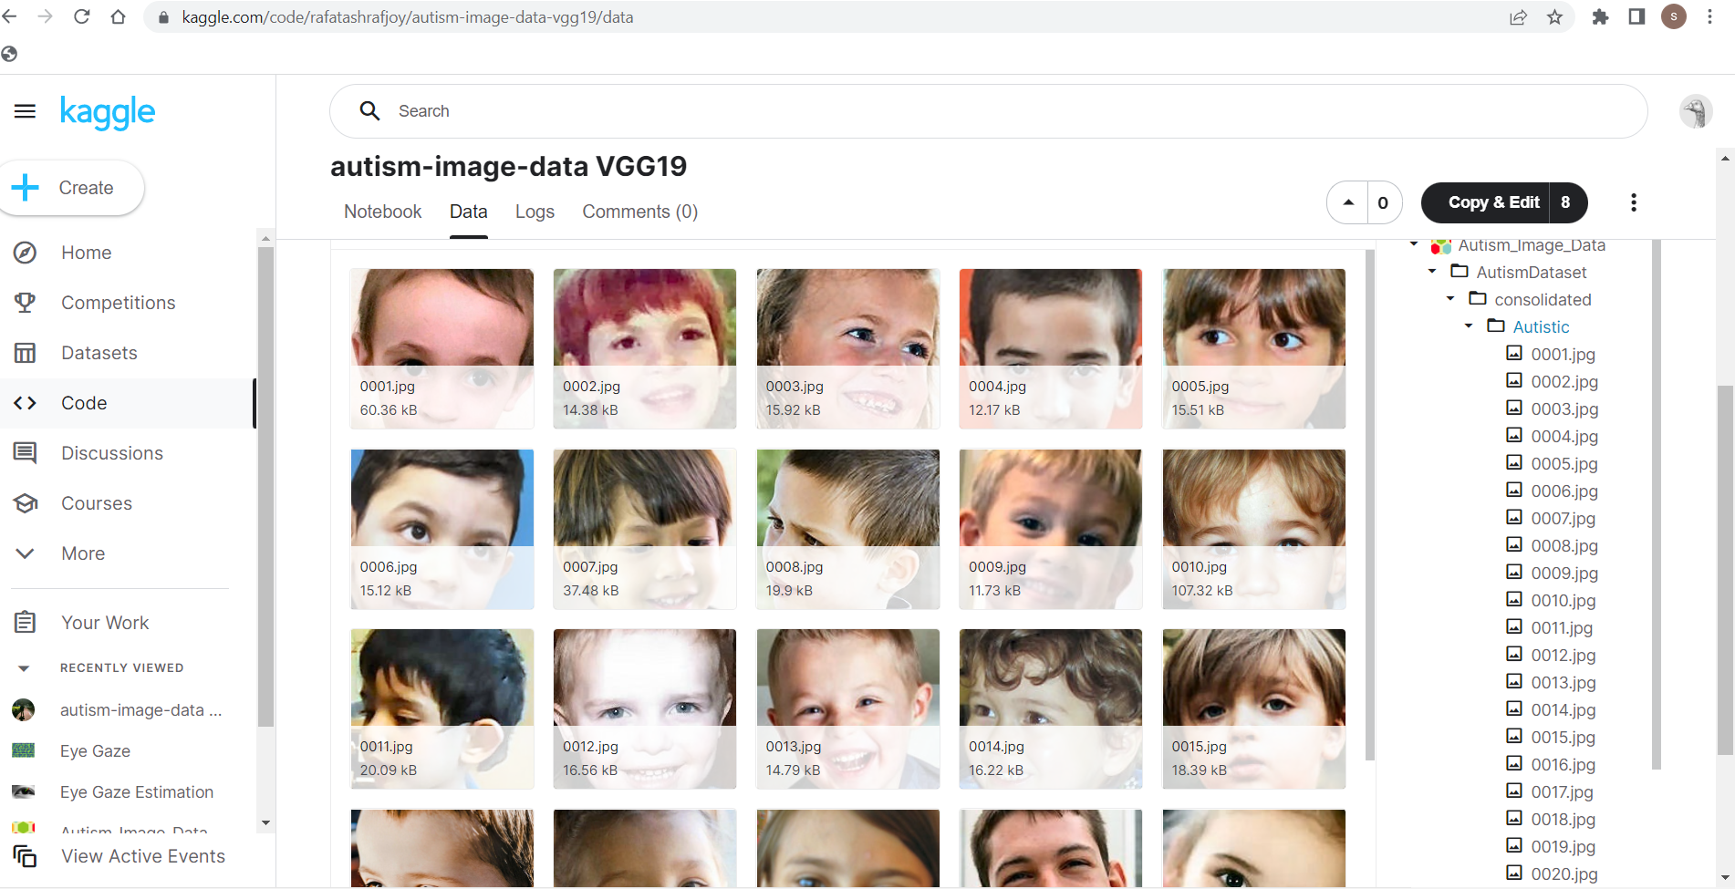

Slide 10
IMPLEMENTATION PLATFORM / FRAMEWORK
SOFTWARE USED:JUPYTER NOTEBOOK
LANGUAGE:PYTHON
FRAMEWORK:OPENCV,TENSORFLOW
DATASET:IMAGE DATASET OF CHILDREN

Slide 11
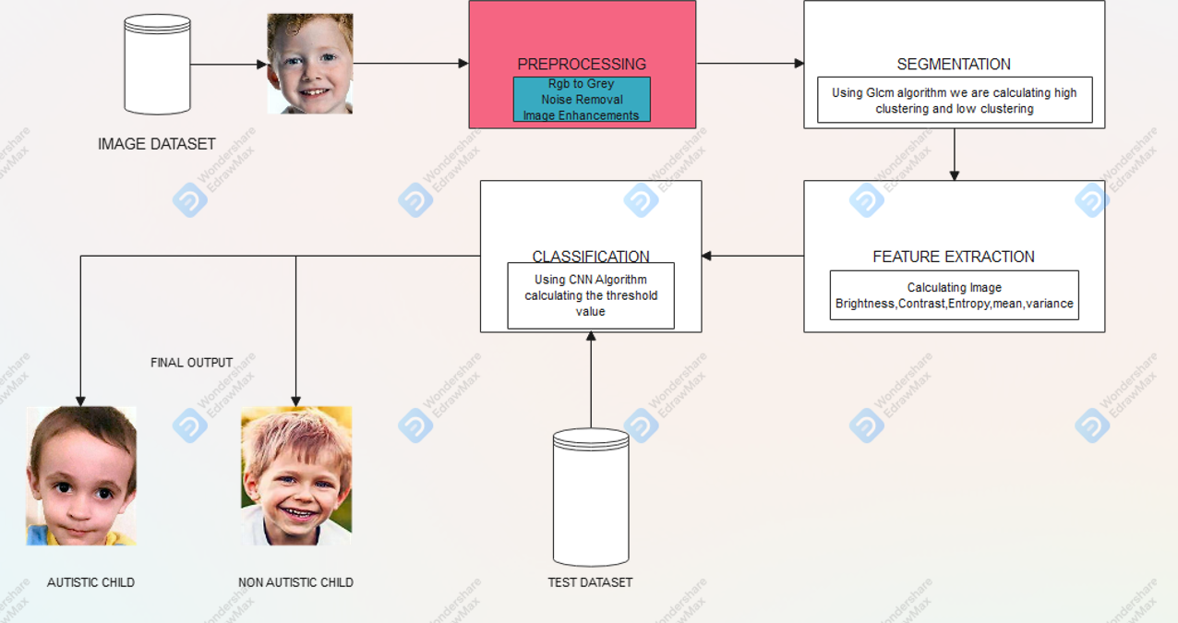
OVERALL ARCHITECTURE DIAGRAM

Slide 12
LIST OF MODULES
1.Preprocessing.
2.Segmentation.
3.Feature Extraction.
4.Classification.
PREPROCESSING:
In this module the given input image is converted into grey format.We need to check any external noise is present.If its present that noise has to be removed by median filter.Then the Image is enhanced and sent for segmentation.

Slide 13
SEGMENTATION:
In this module the given image is been segmented. We will segment the image as high and low clusters based on density and threshold. This is done by GLCM algorithm process.
GLCM(GRAY LEVEL COOCCURENCE MATRIX):
A co-occurrence matrix measures the probability of appearance of pairs of pixel values located at a distance in the image. This algorithm is known as GLCM. The matrix defines the probability of joining two pixels , ( , ) that have values i and j with distance d and as an orientation angular.
FEATURE EXTRACTION:
In this module the features such as amplitude, contract, brightness, entropy, mean, median etc are been extracted and analyzed.
CLASSIFICATION:
In this module the image is been classified using Convolutional Neural Network (CNN) algorithm. This algorithm will help in finding out whether the child is normal child or autism child.

Slide 14
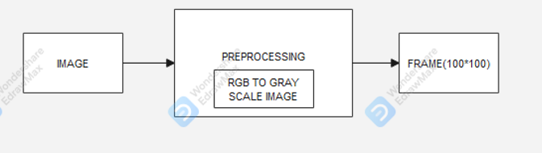
Detailed design of module
PREPROCESSING:
Step1:The images are converted from rgb to grey scale image
SEGMENTATION:
Step1:Using glcm algorithm,high clustering or low clustering is been calculated

Slide 15
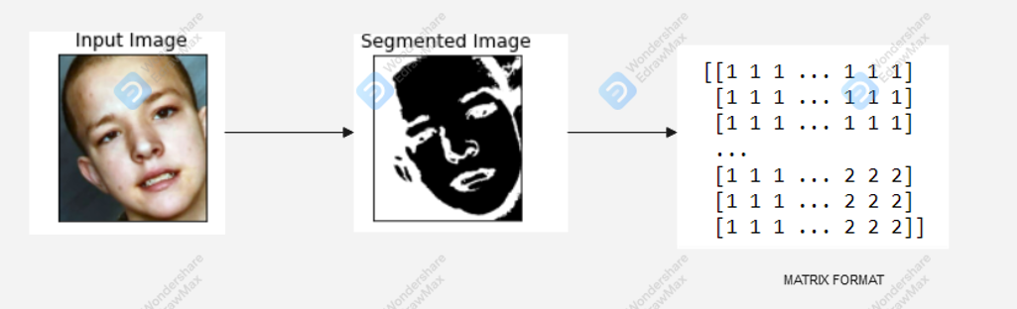
BLOCK DIAGRAM:
FEATURE EXTRACTION:
Step1:Using feature extraction,mean,variance,entropy, brightness,contrast is been calculated by PCA algorithm.

Slide 16
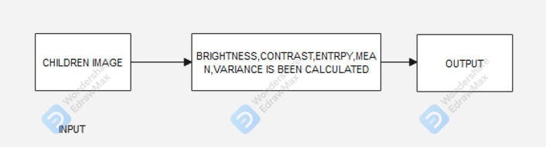
BLOCK DIAGRAM:
CLASSIFICATION:
Step1:using cnn algorithm, testing dataset of children image is taken and threshold value is calculated and we are predicting the child is autistic or non-autistic child

Slide 17
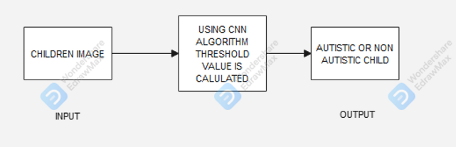
BLOCK DIAGRAM:

Slide 18
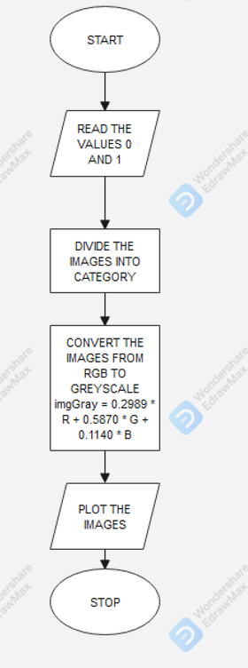
ALGORITHM STEPS
PREPROCESSING:
Step1:Start
Step2:Read the images non autistic as zero and autistic as one
Stpe3:Divide the images into categories
Step4:Convert the images from rgb to grey scale image using the formula
imgGray = 0.2989 * R + 0.5870 * G + 0.1140 * B
Step5:plot the image as grey scale format
FLOWCHART FOR PREPROCESSING:

Slide 19
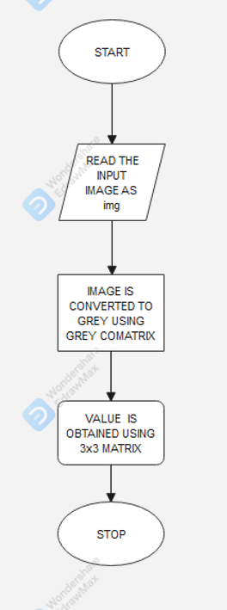
SEGMENTATION: FLOWCHART FOR SEGMENTATION:
Step1:start
Step2:Input:image dataset of children
output:matrix format
Step3:image is converted to grey image using greycomatrix
Step4:using glcm algorithm we are calculating high clustering or low clustering.
Step5:stop

Slide 20
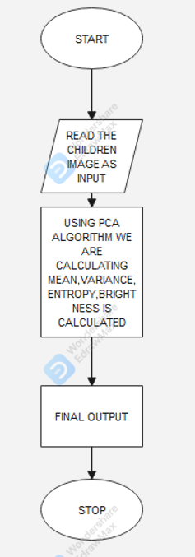
FEATURE EXTRACTION: FLOW CHART FOR FEATURE EXTRACTION
Step1: Start
Step2:Input:image dataset of children
output:Brightness,mean ,variance,entropy values are calculated
Step3:using principle component analysis(PCA) algorithm brightness
mean,variance,entropy is been calculated
Step4:stop

Slide 21
CLASSIFICATION:
Step1:Start
Step2:using cnn algorithm, testing dataset of children image is taken and threshold value is calculated and we are predicting the child is autistic or non-autistic child
Step3:Input:Testing image dataset of children
Output:Threshold value
Step4:If threshold value > 1 it is said to be autistic and if the threshold value < 1 it is said to be non-autistic.
Step5:Stop

Slide 22
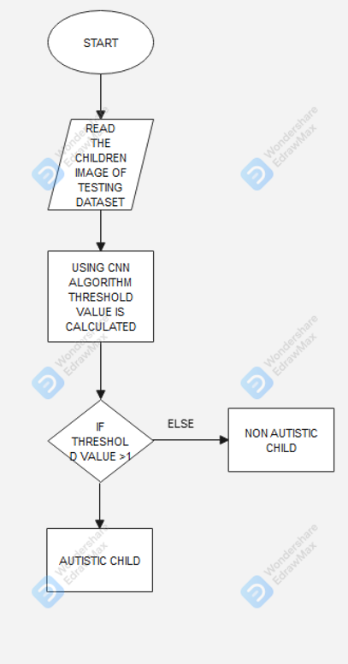
FLOWCHART FOR CLASSIFICATION:

Slide 23
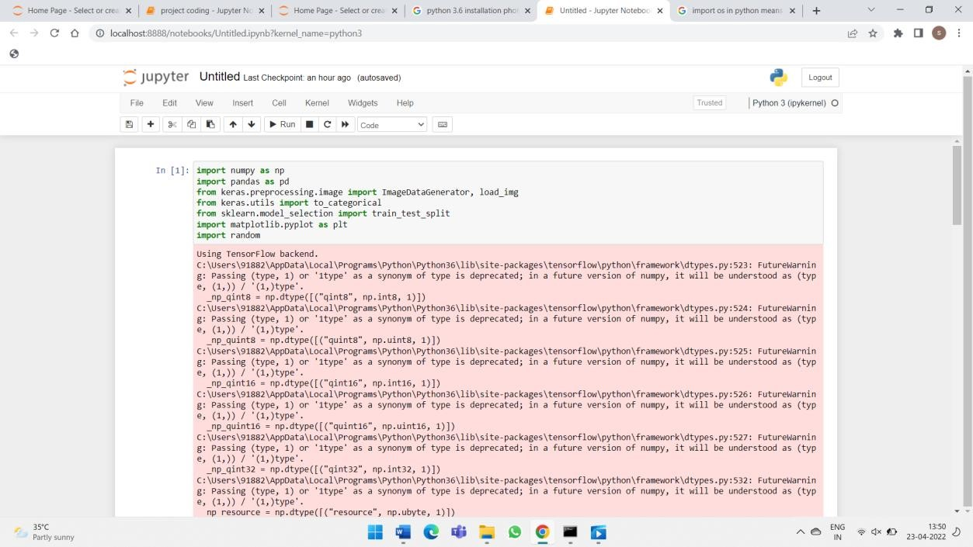
MODULE BASED OUTPUT SCREENSHOT
PREPROCESSING OUTPUT:
PACKAGE INSTALLATION:

Slide 24
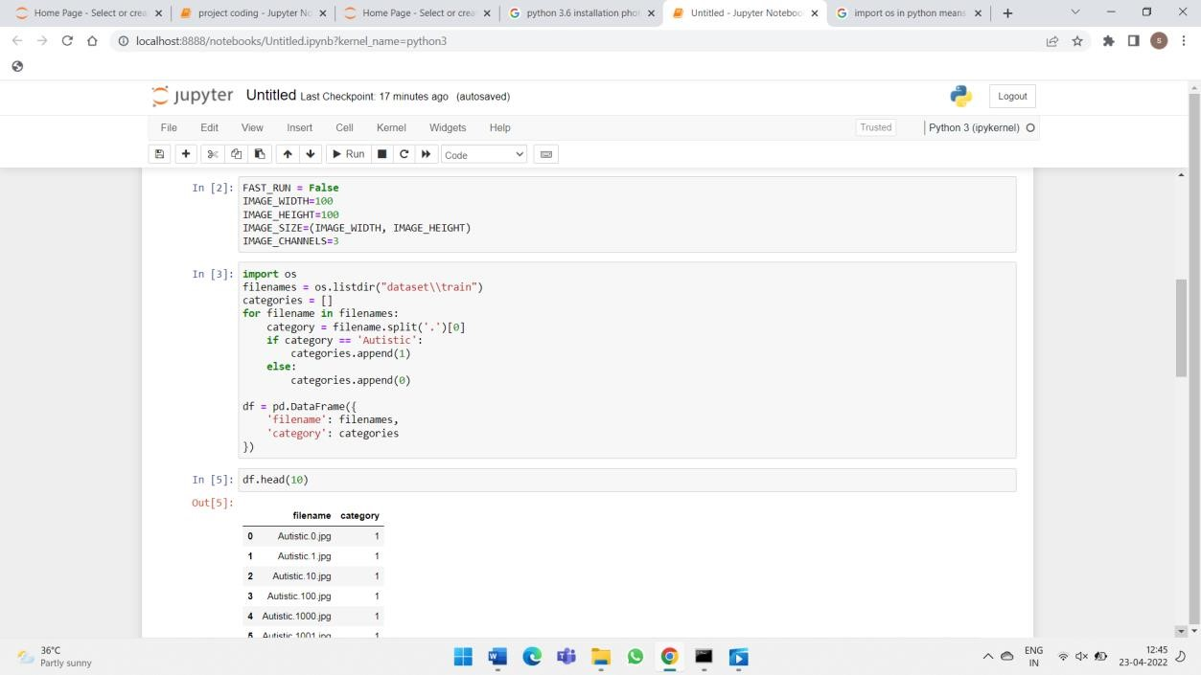
INSERTING DATASET:

Slide 25
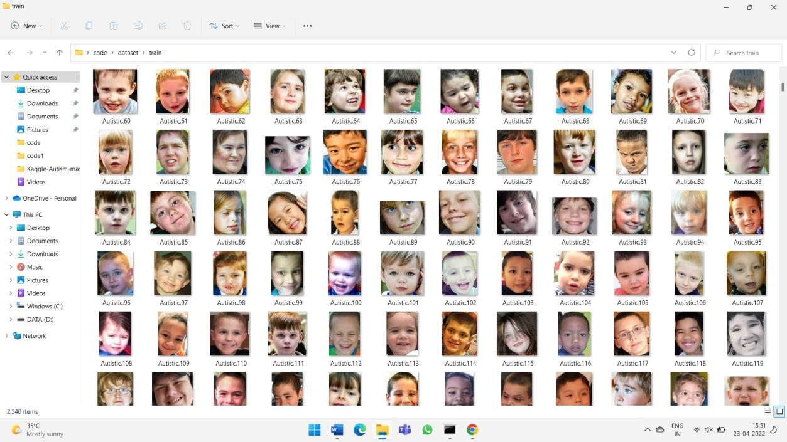

Slide 26
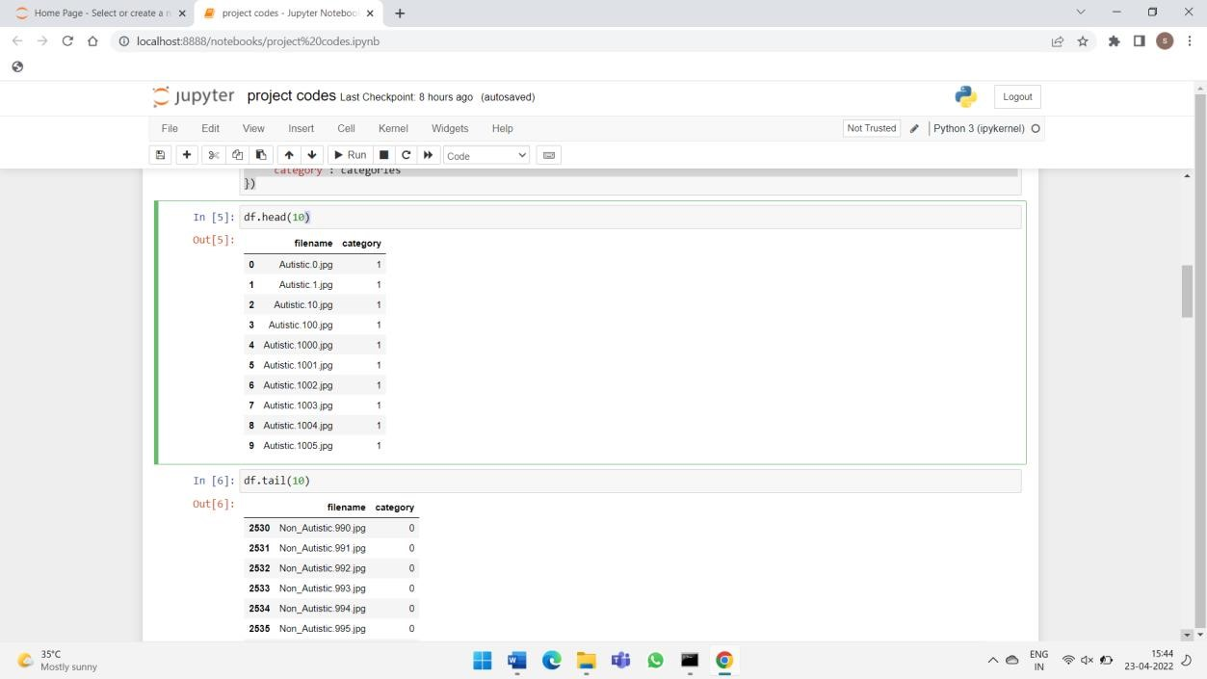
CATEGORYWISE SPLITTING:

Slide 27
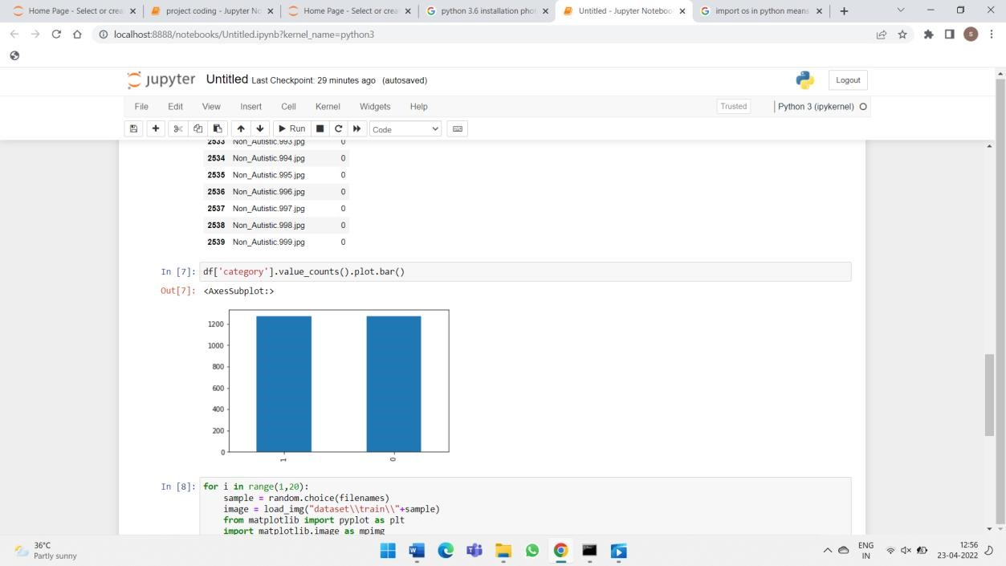

Slide 28
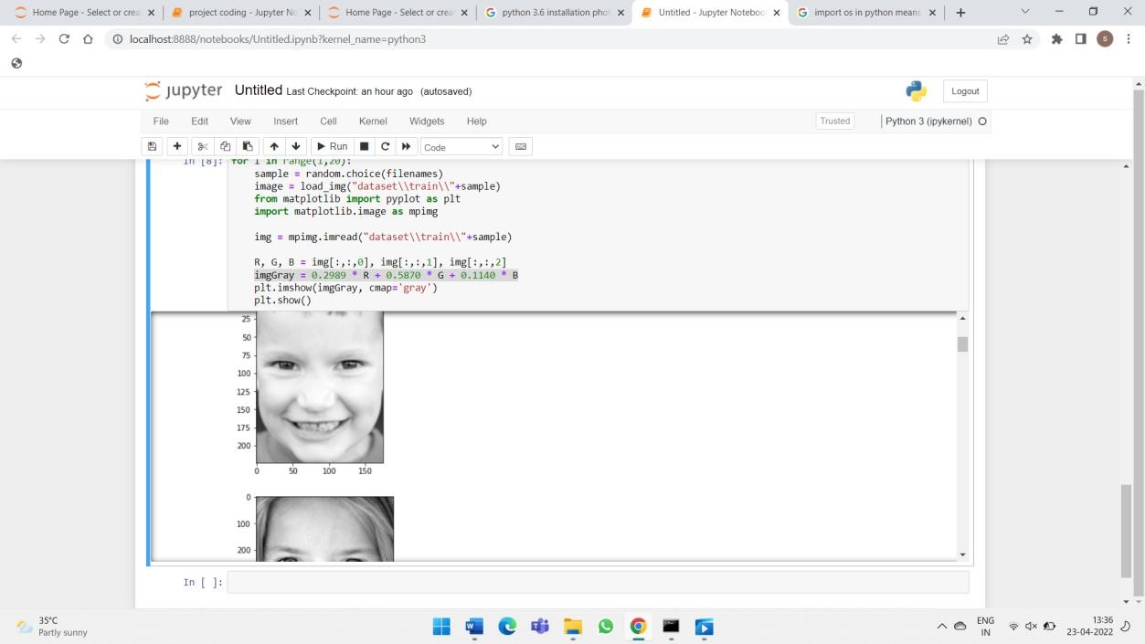
GRAY SCALE IMAGE:

Slide 29
REFERENCES
1. Heinsfeld, A. S., Franco, A. R., Craddock, R. C., Buchweitz, A., & Meneguzzi, F. (2020). Identification of autism spectrum disorder using deep learning and the ABIDE dataset. NeuroImage: Clinical, 17, 16-23.
2. Nair, B. B., &,Rahul Raghunath (2020). Coding and functional defect region prediction of placental protein in an embryo cell of first trimester using ANN approach. In Recent Findings in Intelligent Computing Techniques (pp. 167-170). Springer, Singapore.
3. Rani, N. S., &Vasudev, T. (2021). A Comparative Study on Efficiency of Classification Techniques with Zone Level Gabor Features towards Handwritten Telugu Character Recognition. International Journal of Computer Applications, 148(1).
4. Chanel, G., Pichon, S., Conty, L., Berthoz, S., Chevallier, C., &Grèzes, J. (2020). Classification of autistic individuals and controls using cross-task characterization of fMRI activity. NeuroI mage: Clinical, 10, 78-88.
5. Qureshi, M. N. I., Min, B., Jo, H. J., & Lee, B. (2021). Multiclass classification for the differential diagnosis on the ADHD subtypes using recursive feature elimination and hierarchical extreme learning machine: structural MRI study. PloS one, 11(8), e0160697.

